Slide 1

Time Series Analysis

Slide 2
Introduction
A time series is a series of data points recorded at different time-intervals.
A time-series analysis consists of methods
for analyzing time-series data in order to extract meaningful insights
other valuable characteristics of data
Examples:
the price of a stock in the stock market at different points of time on a given day.
the amount of rainfall in a region at different months of the year

Slide 3
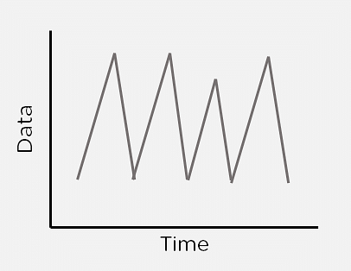
If plotted, the Time series would always have one of its axes as time.
Time series analysis can be useful to see how a given asset, security, or economic variable changes over time.

Slide 4
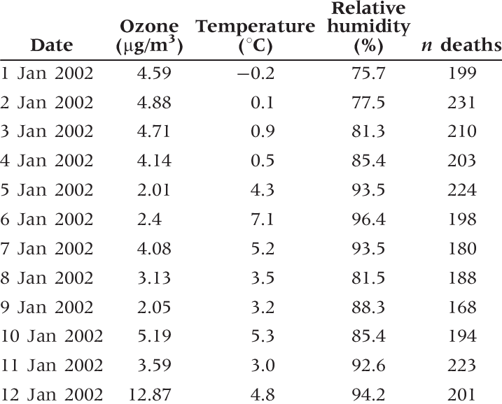

Slide 5
A scenario for Time Series Analysis
Consider the running of a bakery.
Given the data of the past few months, you can predict what items you need to bake at what time.
The morning crowd would need more bread items, like bread rolls, croissants, breakfast muffins, etc.
At night, people may come in to buy cakes and pastries or other dessert items.
Using time series analysis, you can predict items popular during different times and even different seasons.

Slide 6
Components of Time Series Analysis
Trend
Seasonality
Irregularity
Cyclic
Stationary

Slide 7
Trend
The Trend shows the variation of data with time or the frequency of data.
You can see how your data increases, decreases or remain stable over time
Over time, population, stock market fluctuations, and production in a company are all examples of trends.

Slide 8
Seasonality
Seasonality is used to find the variations which occur at regular intervals of time.
Examples are festivals, conventions, seasons, etc.
These variations usually happen around the same time period
affect the data in specific ways which you can predict.

Slide 9
Irregularity
Fluctuations in the time series data do not correspond to the trend or seasonality
These variations in your time series are purely random and usually caused by unforeseeable circumstances
Example: sudden decrease in population because of a natural calamity

Slide 10
Cyclic
Oscillations in time series which last for more than a year are called cyclic.
They may or may not be periodic.

Slide 11
Stationary
A time series that has the same statistical properties over time is stationary.
The properties remain the same anywhere in the series.
A stationary series has a constant mean, variance, and covariance.

Slide 12
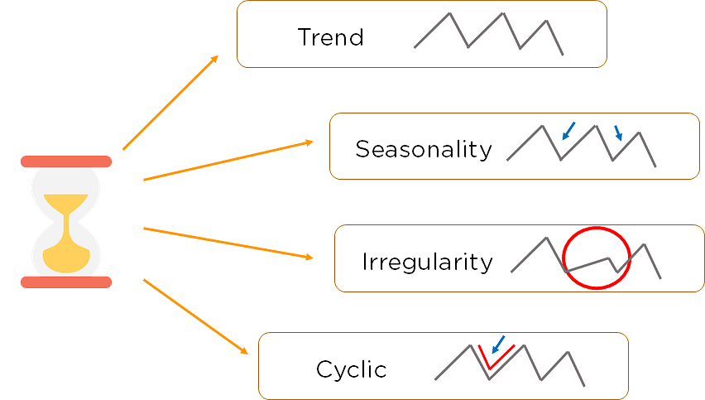

Slide 13
Time Series Forecasting Methods
Autoregression (AR)
Moving Average (MA)
Autoregressive Moving Average (ARMA)
Autoregressive Integrated Moving Average (ARIMA)
Seasonal Autoregressive Integrated Moving-Average (SARIMA)
Seasonal Autoregressive Integrated Moving-Average with Exogenous Regressors (SARIMAX)

Slide 14
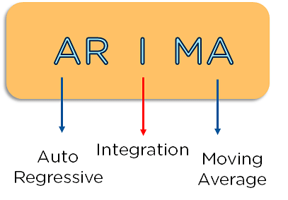
ARIMA
ARIMA Model stands for Auto-Regressive Integrated Moving Average.
It is used to predict the future values of a time series using its past values and forecast errors.

Slide 15
AutoRegressive (AR) component
it models the relationship between the current value of a time series and its past values
It is denoted by the parameter 'p'
it indicates how many previous time points are considered to predict the current value

Slide 16
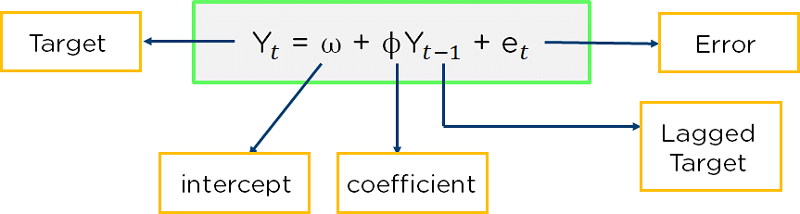
Auto-Regressive models predict future behavior using past behavior where there is some correlation between past and future data.
It is a modified version of the slope formula
value of the time series at a previous time point
denoted as Y(t-k), where "k" represents the number of time points in the past

Slide 17
Integrated (I) component
The I component represents differencing in the time series data to make it stationary.
Stationarity is an important concept in time series analysis
it means that the statistical properties of the time series (e.g., mean and variance) do not change over time.
It is denoted by the parameter 'd'
'd' indicates how many times differencing is required to make the data stationary.

Slide 18
Moving Average (MA) component
The MA component models the relationship between the current value of a time series and past forecast errors.
It is denoted by the parameter 'q'
it indicates how many past forecast errors are considered in predicting the current value

Slide 19
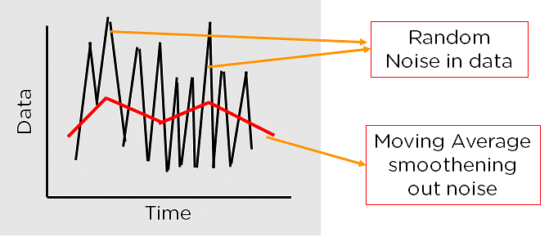
Moving Average is a statistical method that helps to cut down the noise from the data

Slide 20
The ARIMA model is usually represented as ARIMA(p, d, q)

Slide 21
THANK YOU

